Slide 1
Naomi Carl
STAR FORMATION HISTORY OF NGC 3344
ASU/NASA Space Grant

Slide 2
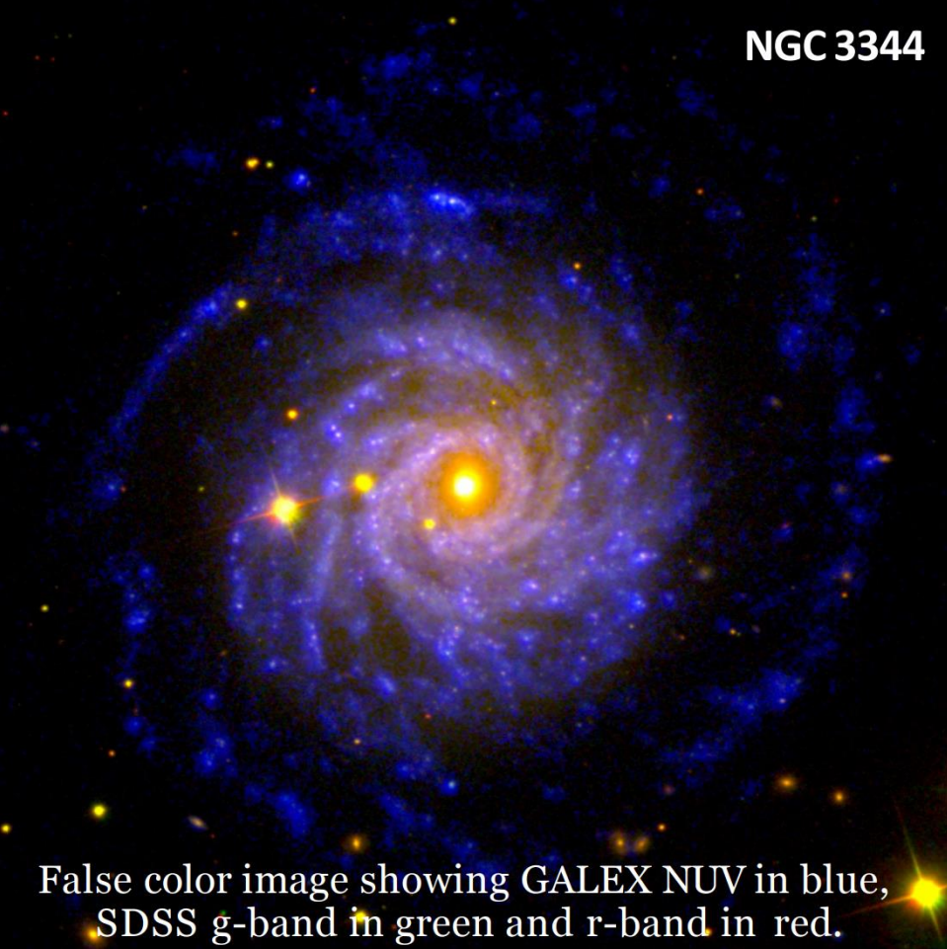
Why NGC 3344?
Nearby, face-on galaxy
Previous work demonstrated inside-out galaxy formation
Extended UV disk (Padave et. al., 2021)
Indicative of recent starburst
SED fitting can reveal the SFH of the galaxy

Slide 3
Methodology
fluxes
SED fitting
modeling
LBT
(Large Binocular Telescope)
Parameters
SFH, Dust, etc.
Galex FUV & NUV, Sloan g, r, u, & i,
MIPS 24 micron
z = 0.001961,
distance = 8.28 Mpc,
Age, starburst, power law, metallicity,
Approximately 5,715,360 models run for the final combination

Slide 4
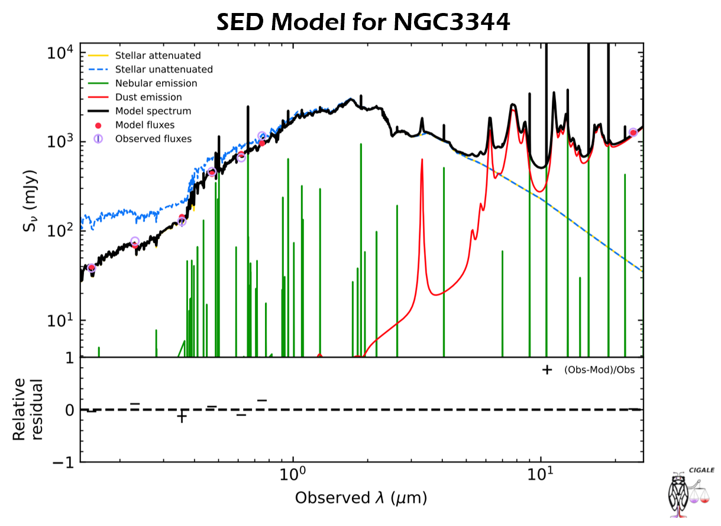
Results:
Best fit SED has a 𝛘² value of only 0.022
Double exponential SFH produced most accurate results
Draine 2014 Dust Emission Model fits best

Slide 5
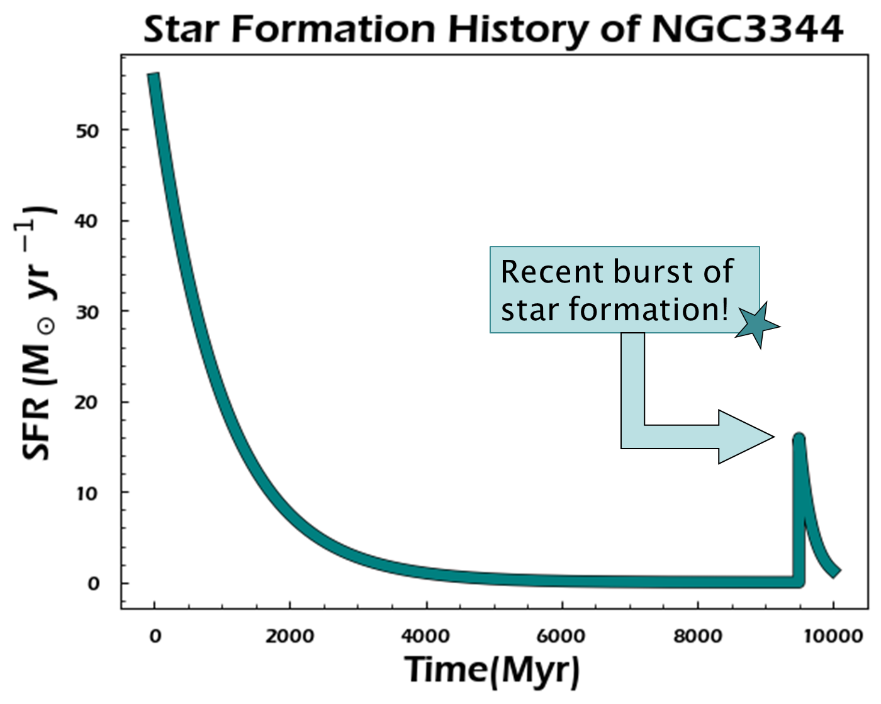
Star Formation History:
SFH has recent spike within last 200 million years!
Mass: 10.6 log⁡(M★/M☉)
Age of main stellar population: 8500 Myr
Dust mass: 7.6 log⁡(𝑀★ /𝑀☉)

Slide 6
Conclusions & Future Work:
A starburst within the last 200 Myr may corroborate evidence from Padave et al. 2021
This would explain the XUV disc present in NGC 3344, but we still need to investigate what caused this burst
Explore annular star formation histories of the galaxy
Examine growth of the galactic disc in detail
Investigate properties of the stellar associations
Unveil underlying stellar populations

Slide 7
Thank you.
Mansi Padave
Sanchayeeta Borthakur
ASU/NASA Space Grant Program
Desiree Crawl & Tom Sharp

